Slide 1
Al-Farabi Kazakh National University
Higher School of Medicine
Department of Fundamental Medicine
Transcriptomics. Methods of transcriptome investigation.
Lecturer and creator: PhD Pinsky Ilya Vladimirovich
Notes:
Weaver, PART I

Slide 2
LEARNING OUTCOMES
As a result of the lesson you will be able to:
1. Give the definition to the following terms: “transcript”, “transcriptome”, “transcriptomics”, “gene expression profile”.
2. Describe and analyze the different types of RNA by their structure and functions.
3. Explain the methods of different RNA extraction, amplification and sequencing.
4. Explain how the methods of gene expression profiling, RNA microarray and RNA-seq can be used for diagnostics of different diseases?

Slide 3
Definition
Transcriptomics technologies are the techniques used to study an organism's transcriptome, the sum of all of its RNA transcripts. The information content of an organism is recorded in the DNA of its genome and expressed through transcription. Here, mRNA serves as a transient intermediary molecule in the information network, whilst non-coding RNAs perform additional diverse functions. A transcriptome captures a snapshot in time of the total transcripts present in a cell. Transcriptomics technologies provide a broad account of which cellular processes are active and which are dormant. A major challenge in molecular biology lies in understanding how the same genome can give rise to different cell types and how gene expression is regulated [1].

Slide 4
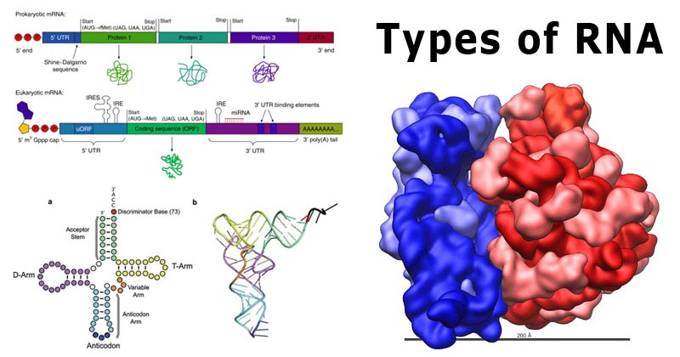
https://microbenotes.com/types-of-rna/

Slide 5
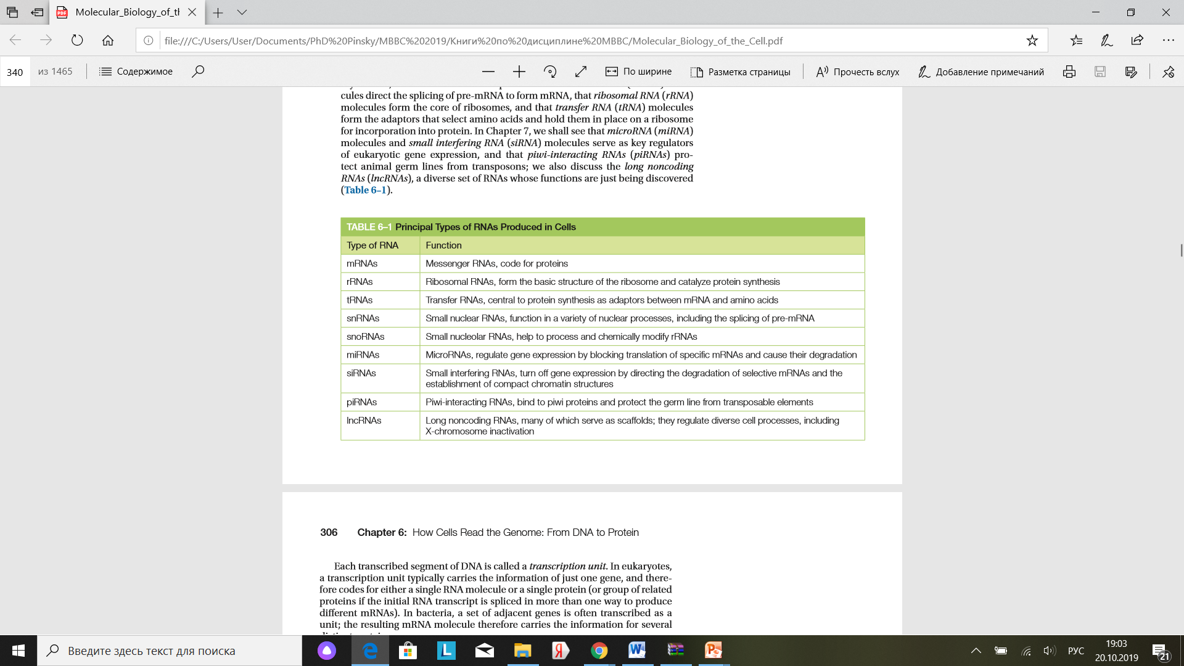
Alberts B. et al. Molecular biology of the cell. 6th ed. 2015. Garland Science. – p. 305.

Slide 6
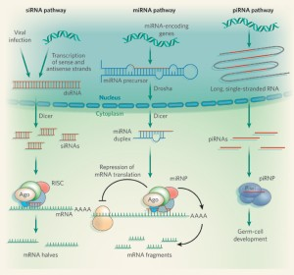
https://www.nature.com/articles/451414a

Slide 7
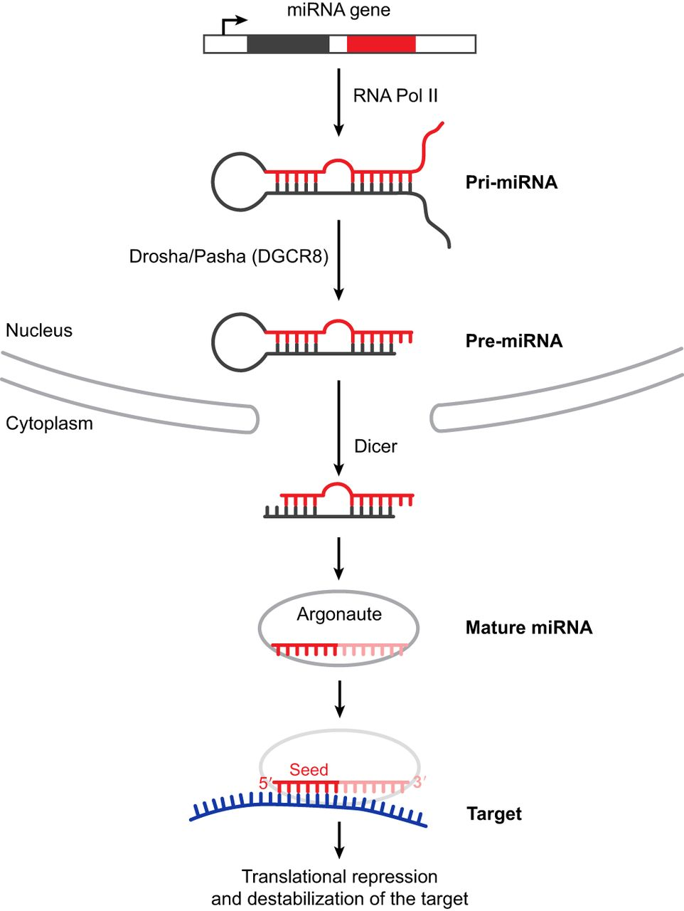
https://dev.biologists.org/content/144/14/2548

Slide 8
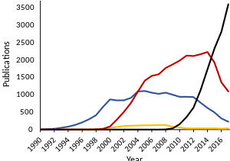
Transcriptomics method use over time. Published papers referring to RNA-Seq (black), RNA microarray (red), expressed sequence tag (blue) and serial/cap analysis of gene expression (yellow) since 1990.[1]

Slide 9
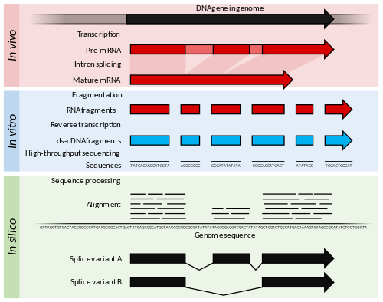
RNA-seq
Shafee T, Lowe R (2017). "Eukaryotic and prokaryotic gene structure". WikiJournal of Medicine. 4 (1). doi:10.15347/wjm/2017.002.

Slide 10
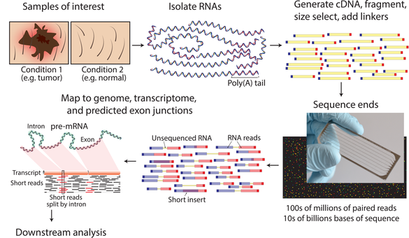
Griffith M, Walker JR, Spies NC, Ainscough BJ, Griffith OL (August 2015). "Informatics for RNA Sequencing: A Web Resource for Analysis on the Cloud". PLOS Computational Biology. 11 (8): e1004393. Bibcode:2015PLSCB..11E4393G. doi:10.1371/journal.pcbi.1004393. PMC 4527835. PMID 26248053.

Slide 11
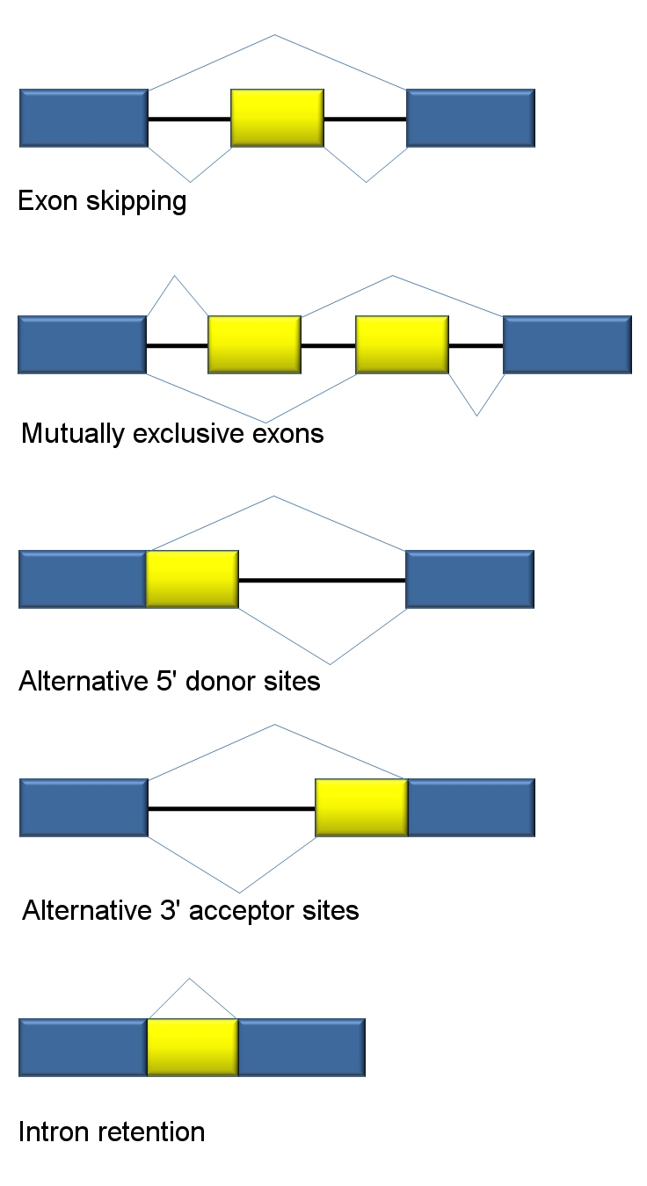
Alternative RNA splicing event types. Exons are represented as blue and yellow blocks, introns as lines in between.
https://en.wikipedia.org/wiki/RNA-Seq#/media/File:Alt_splicing_bestiary2.jpg

Slide 12
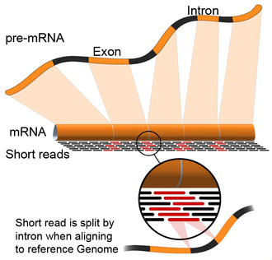
https://en.wikipedia.org/wiki/RNA-Seq#cite_note-ReferenceA-8

Slide 13
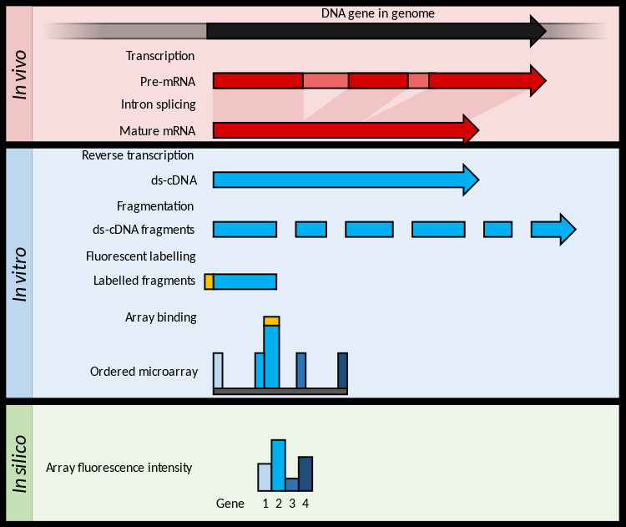
DNA Microarrays
https://en.wikipedia.org/wiki/Transcriptomics_technologies#/media/File:Summary_of_RNA_Microarray.svg

Slide 14
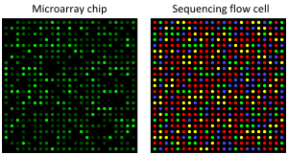
Microarray and sequencing flow cell. Microarrays and RNA-seq rely on image analysis in different ways. In a microarray chip, each spot on a chip is a defined oligonucleotide probe, and fluorescence intensity directly detects the abundance of a specific sequence (Affymetrix). In a high-throughput sequencing flow cell, spots are sequenced one nucleotide at a time, with the colour at each round indicating the next nucleotide in the sequence (Illumina Hiseq). Other variations of these techniques use more or fewer colour channels. [2], [3]

Slide 15
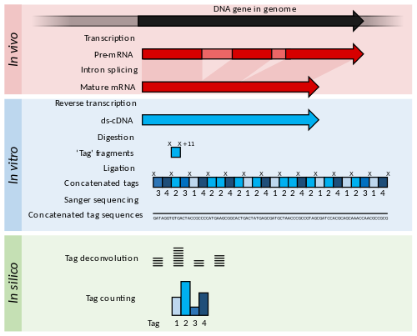
Serial and cap analysis of gene expression (SAGE/CAGE)
Lowe R, Shirley N, Bleackley M, Dolan S, Shafee T (May 2017). "Transcriptomics technologies". PLOS Computational Biology. 13 (5): e1005457. Bibcode:2017PLSCB..13E5457L. doi:10.1371/journal.pcbi.1005457. PMC 5436640. PMID 28545146.

Slide 16
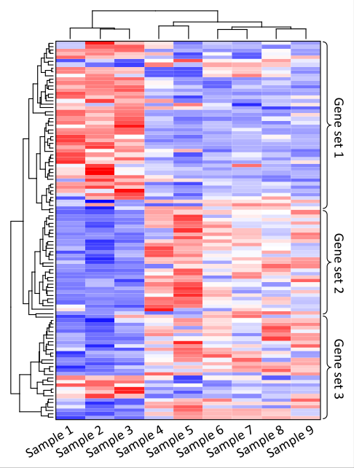
Gene expression profiling
Heatmap identification of gene co-expression patterns across different samples. Each column contains the measurements for gene expression change for a single sample. Relative gene expression is indicated by colour: high-expression (red), median-expression (white) and low-expression (blue). Genes and samples with similar expression profiles can be automatically grouped (left and top trees). Samples may be different individuals, tissues, environments or health conditions. In this example, expression of gene set 1 is high and expression of gene set 2 is low in samples 1, 2, and 3. [3], [4]
https://en.wikipedia.org/wiki/Transcriptomics_technologies#/media/File:Transcriptomes_heatmap_example.svg

Slide 17
References
"Transcriptomics technologies". PLOS Computational Biology. 13 (5): e1005457. 18 May 2017. doi:10.1371/JOURNAL.PCBI.1005457. ISSN 1553-734X. PMC 5436640. PMID 28545146. S2CID 3714586. Wikidata Q33703532.
Lowe R, Shirley N, Bleackley M, Dolan S, Shafee T (May 2017). "Transcriptomics technologies". PLOS Computational Biology. 13 (5): e1005457. Bibcode:2017PLSCB..13E5457L. doi:10.1371/journal.pcbi.1005457. PMC 5436640. PMID 28545146.
Petrov A, Shams S (2004-11-01). "Microarray Image Processing and Quality Control". Journal of VLSI Signal Processing Systems for Signal, Image and Video Technology. 38 (3): 211–226.
Lowe R, Shirley N, Bleackley M, Dolan S, Shafee T (May 2017). "Transcriptomics technologies". PLOS Computational Biology. 13 (5): e1005457. Bibcode:2017PLSCB..13E5457L. doi:10.1371/journal.pcbi.1005457. PMC 5436640. PMID 28545146.

